Slide 1
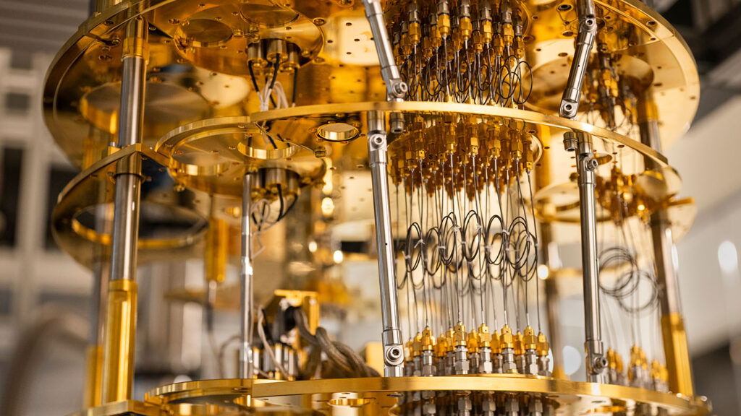
Quantum Computing
Cover: ‘Microsoft Has Demonstrated the Underlying Physics Required to Create a New Kind of Qubit’. Microsoft Research, March 14, 2022, https://www.microsoft.com/en-us/research/blog/microsoft-has-demonstrated-the-underlying-physics-required-to-create-a-new-kind-of-qubit/.
Another peek into
Kees van Kempen May 31, 2022 @ student seminar PMM
<ru@keesvankempen.nl>

Slide 2
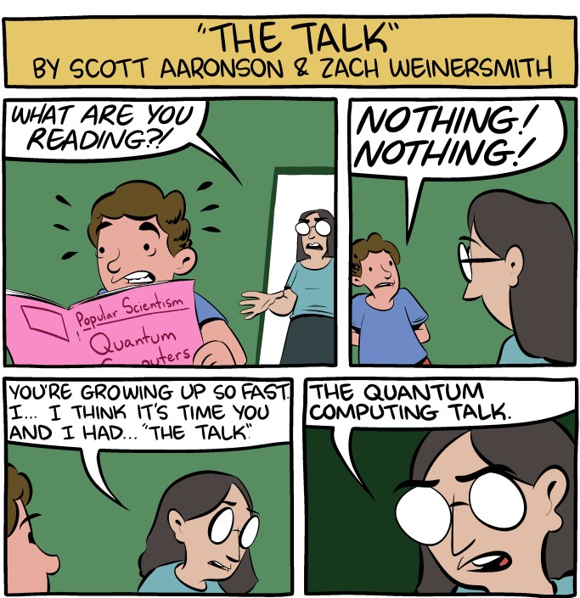
Presentation goals
Motivate the potential of quantum computing (QC)
Demystify the buzz around QC
Specifically not:
  Go deeply into the mathematics
  Cover every (important) notion of QC
  Give a lecture on (quantum) information
Saturday Morning Breakfast Cereal - The Talk. https://www.smbc-comics.com/comic/the-talk-3.

Slide 3
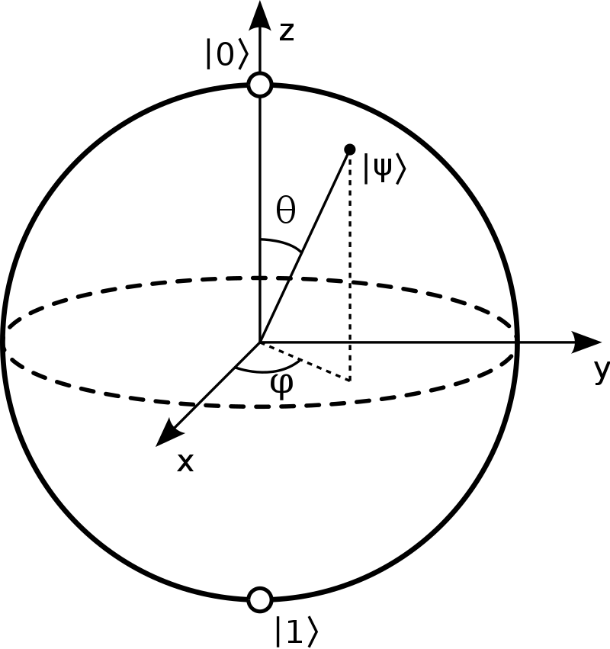
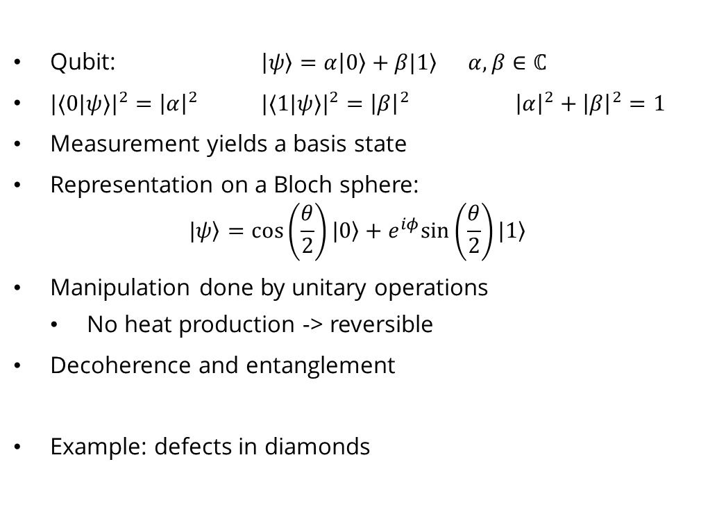
Recap from “Qubits in Diamond” by Jeroen (May 10, 2022)
Qubit: $\left|\left.ψ\right\rangle =α\right|\left.0\right\rangle +β|\left.1\right\rangle α,β∈\text{ℂ}$
${|⟨0|ψ⟩|}^{2}=$ ${\left|α\right|}^{2}$ ${|⟨1|ψ⟩|}^{2}={\left|β\right|}^{2}$ ${{\left|α\right|}^{2}+\left|β\right|}^{2}=1$
Measurement yields a basis state
Representation on a Bloch sphere:
$|\left.ψ\right\rangle =cos\left(\frac{θ}{2}\right)|\left.0\right\rangle +e^{iφ}sin\left(\frac{θ}{2}\right)|\left.1\right\rangle$
Manipulation done by unitary operations
  No heat production -> reversible
Decoherence and entanglement
Example: defects in diamonds
Notes:
An operation U is unitary of U^{-1} = U^*, that is, the norm of the wave vector is conserved. This allows undoing the operation, thus rendering it reversible.

Slide 4
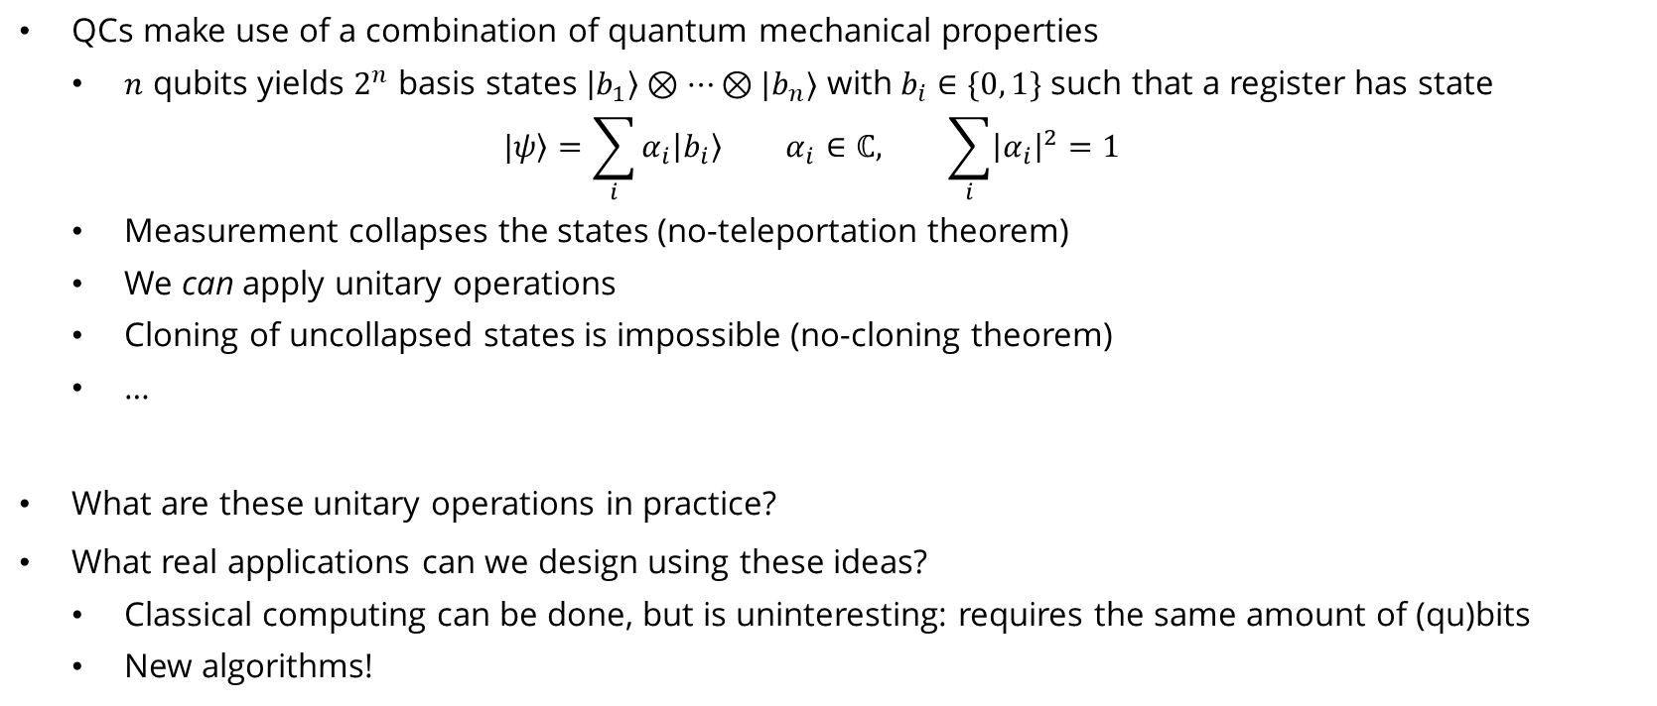
Qubits, and then?
QCs make use of a combination of quantum mechanical properties
  $n$ qubits yields $2^{n}$ basis states $\left|b_{1}\right\rangle ⊗…⊗|b_{n}⟩$ with $b_{i}∈\{0, 1\}$ such that a register has state
  $$\left.|ψ\right\rangle =\sum_{i}{α_{i}\left|b_{i}\right\rangle } α_{i}∈ℂ, \sum_{i}{{\left|α_{i}\right|}^{2}}=1$$
  Measurement collapses the states (no-teleportation theorem)
  We can apply unitary operations
  Cloning of uncollapsed states is impossible (no-cloning theorem)
  …
What are these unitary operations in practice?
What real applications can we design using these ideas?
  Classical computing can be done, but is uninteresting: requires the same amount of (qu)bits
  New algorithms!
Notes:
The information provided by a state is given by the vector of alphas. In classical computing, this vector is one of 2^n elements, namely \alpha_j = 1, and the rest are zero. In quantum computing, we have an infinite amount of states from {0,1}^n.
The no-teleportation theorem states we cannot convert a qubit’s information into classical bits. On the one hand, we can only measure a state, not the amplitudes, and on the other hand, these amplitudes are infinitely precise.

Slide 5
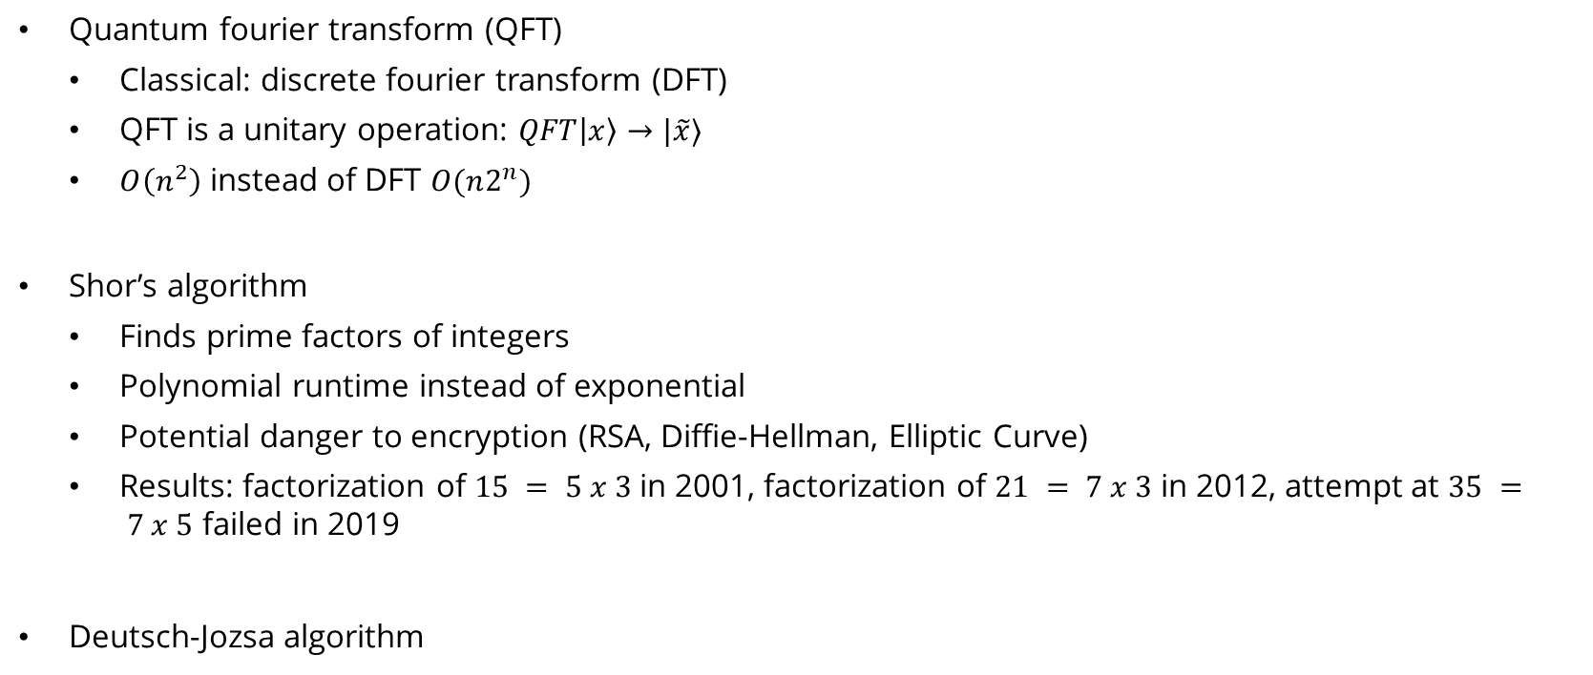
Quantum algorithms
Quantum fourier transform (QFT)
  Classical: discrete fourier transform (DFT)
  QFT is a unitary operation: $QFT\left|x\right\rangle →|\tilde{x}⟩$
  $O\left(n^{2}\right)$ instead of DFT $O(n2^{n})$
Shor’s algorithm
  Finds prime factors of integers
  Polynomial runtime instead of exponential
  Potential danger to encryption (RSA, Diffie-Hellman, Elliptic Curve)
  Results: factorization of $15 = 5 x 3$in 2001, factorization of $21 = 7 x 3$ in 2012, attempt at $35 = 7 x 5$ failed in 2019
Deutsch-Jozsa algorithm

Slide 6
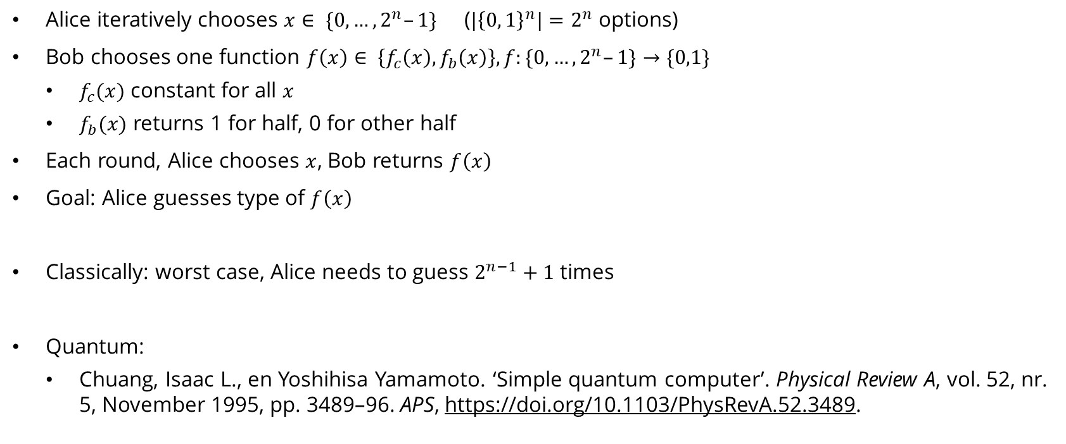
Deutsch-Jozsa problem (1992)
Alice iteratively chooses $x∈ \{0, …, 2^{n}–1\}$ (${|{\left\{0, 1\right\}}^{n}|=2}^{n}$ options)
Bob chooses one function $f\left(x\right)∈ \left\{f_{c}\left(x\right), f_{b}\left(x\right)\right\}, f:\{0, …, 2^{n}–1\}→\{0,1\}$
  $f_{c}(x)$ constant for all $x$
  $f_{b}(x)$ returns 1 for half, 0 for other half
Each round, Alice chooses $x$, Bob returns $f\left(x\right)$
Goal: Alice guesses type of $f\left(x\right)$
Classically: worst case, Alice needs to guess $2^{n−1}+1$ times
Quantum:
  Chuang, Isaac L., en Yoshihisa Yamamoto. ‘Simple quantum computer’. Physical Review A, vol. 52, nr. 5, November 1995, pp. 3489–96. APS, https://doi.org/10.1103/PhysRevA.52.3489.

Slide 7
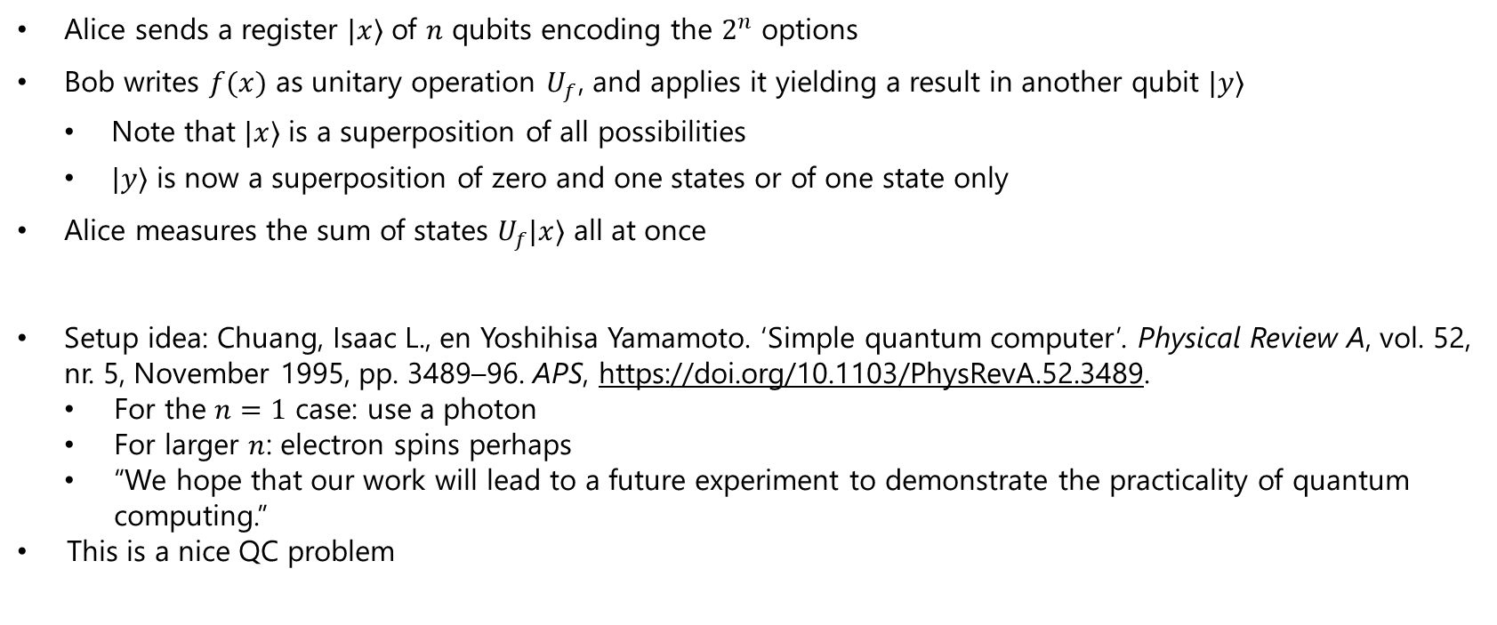
Deutsch-Jozsa algorithm sketch: ‘Simple quantum computer’
Alice sends a register $|x⟩$ of $n$ qubits encoding the $2^{n}$ options
Bob writes $f(x)$ as unitary operation $U_{f}$, and applies it yielding a result in another qubit $|y⟩$
  Note that $|x⟩$ is a superposition of all possibilities
  $|y⟩$ is now a superposition of zero and one states or of one state only
Alice measures the sum of states $U_{f}|x⟩$ all at once
Setup idea: Chuang, Isaac L., en Yoshihisa Yamamoto. ‘Simple quantum computer’. Physical Review A, vol. 52, nr. 5, November 1995, pp. 3489–96. APS, https://doi.org/10.1103/PhysRevA.52.3489.
          For the $n=1$ case: use a photon
          For larger $n$: electron spins perhaps
          “We hope that our work will lead to a future experiment to demonstrate the practicality of quantum computing.”
        This is a nice QC problem

Slide 8
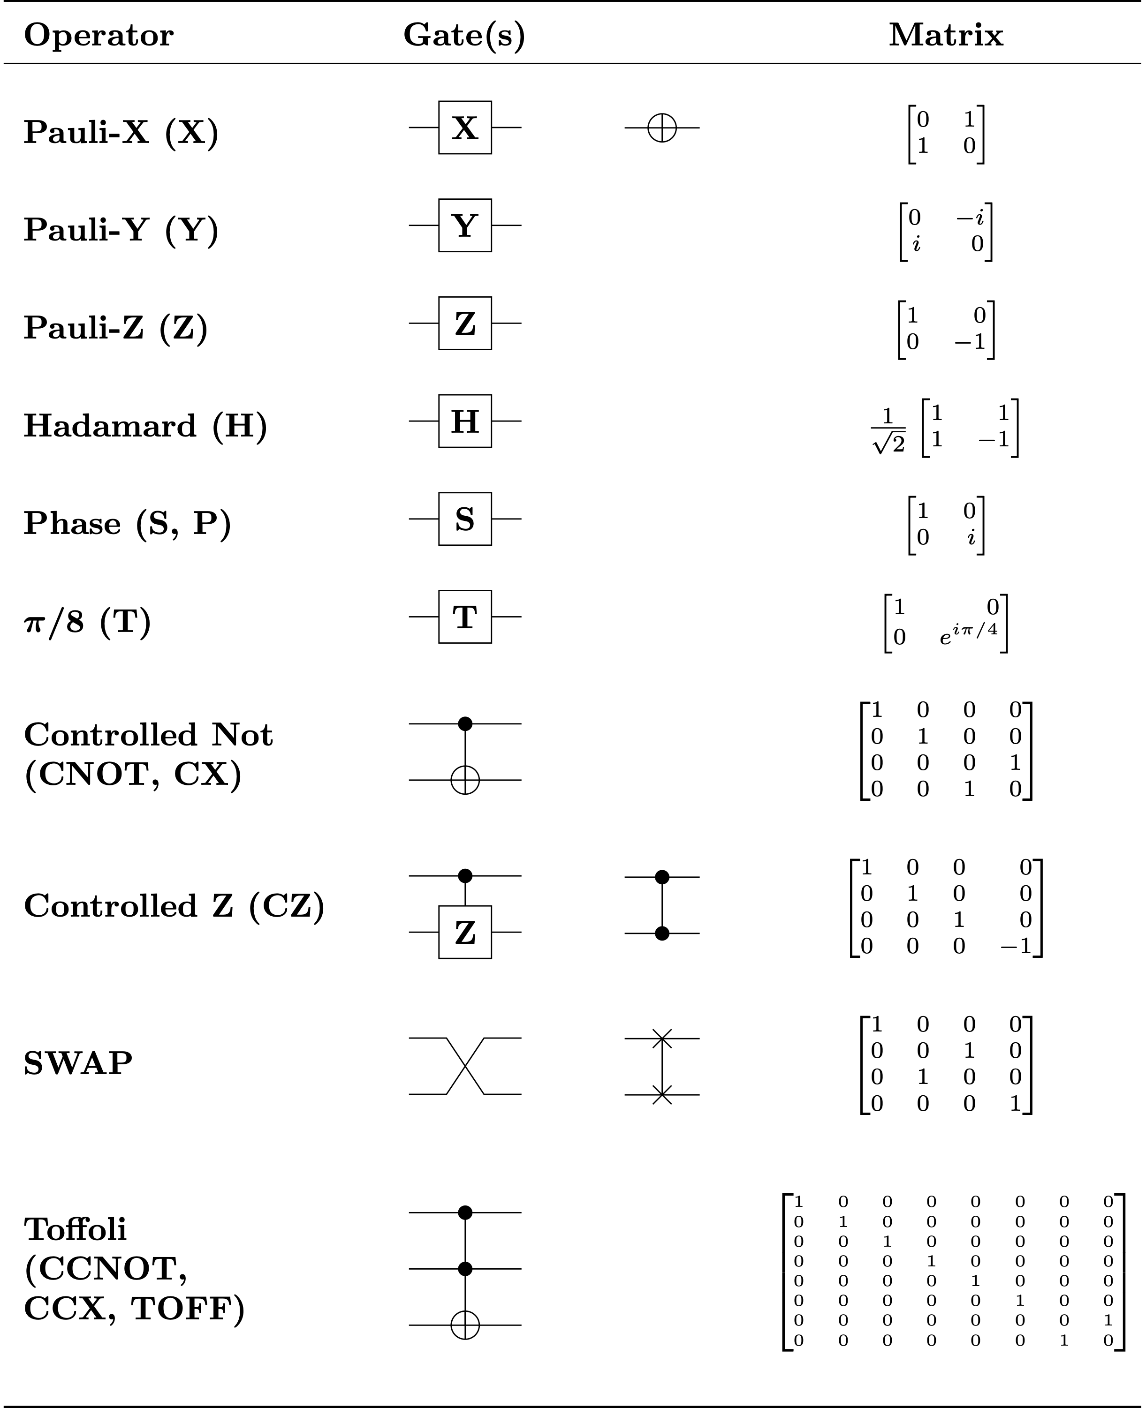
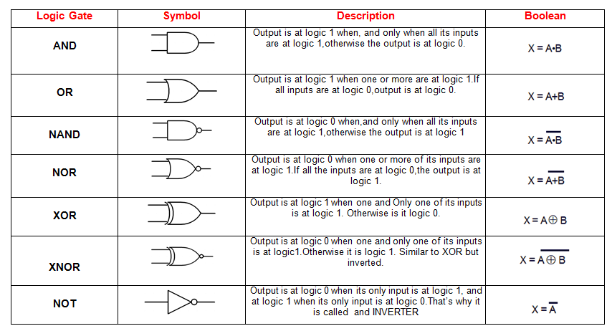
Towards a universal quantum computer

Slide 9
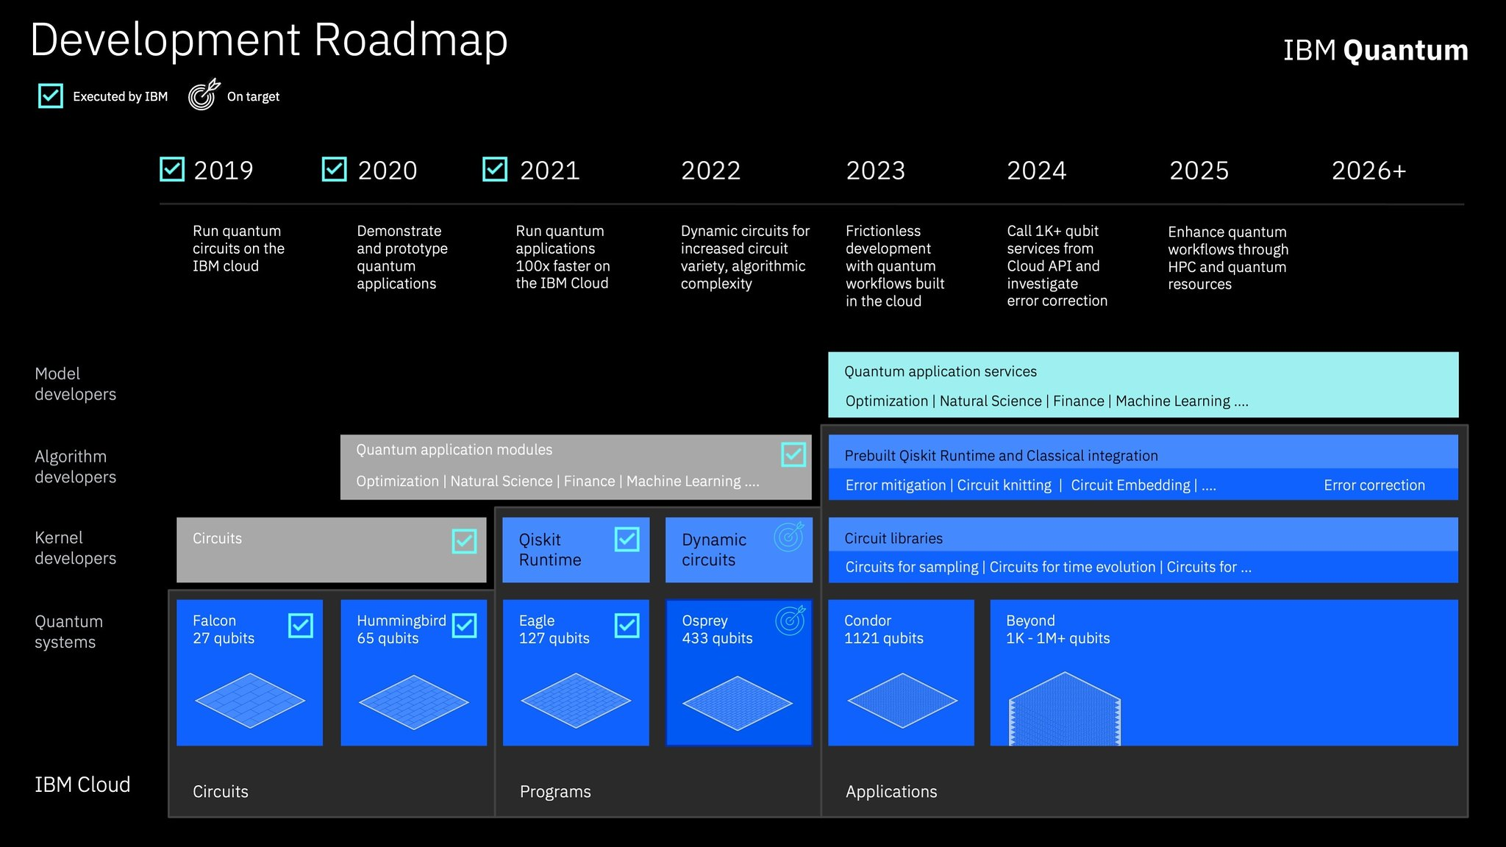
Quantum revolution?

Slide 10
Take-hoMe message
Quantum computing has a good theoretical fundation, but is in its infancy in practice
Quantum computing solves problems differently than normal computing
Further reading tips:
  The given example: Chuang, Isaac L., en Yoshihisa Yamamoto. ‘Simple quantum computer’. Physical Review A, vol. 52, nr. 5, November 1995, pp. 3489–96. APS, https://doi.org/10.1103/PhysRevA.52.3489.
  A review by a physicist: Steane, Andrew. ‘Quantum computing’. Reports on Progress in Physics, vol. 61, nr. 2, February 1998, pp. 117–73. DOI.org (Crossref), https://doi.org/10.1088/0034-4885/61/2/002.
  A proper course on quantum computing: de Wolf, Ronald. ‘Quantum Computing: Lecture Notes’. January 11, 2022. https://homepages.cwi.nl/~rdewolf/#LectureNotes. <- Is this familiar, Floris?

